Slide 1

Mahatma Gandhi Mission's
Jawaharlal Nehru Engineering College Cidco N-6, Aurangabad
Department of Computer Science and Engineering
ACADEMIC YEAR :-2021-22
Group Members
306205 Divya Khedkar
306246 Shashwati Salunke
306108 Akanksha Deshpande

Slide 2
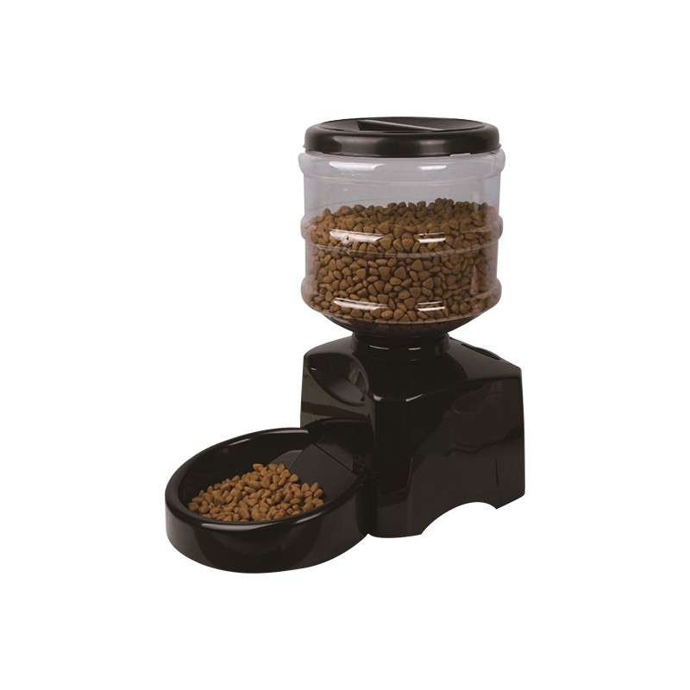
Automated Commercial pet feeder
How is it different from existing products?
Generally lacking sensors and will continue dispensing
Preprogrammed meals even if there is leftover/uneaten
No Additional alerts based on pets eating habits

Slide 3
INTRODUCTION
An innovation in the Pet shop industry which will ease the task of one worker but can be the most useful automation.
Market statement:
Automated pet feeder is one of the new technologies for feed pet. It will help pet owner to take care of their pet while they are not at home. Even the owners are not at home, they still can feed their pet.
Our statement:
Automated commercial pet feeder can be one of the new technologies for feeding pets on a large number. It will help shop owner to take care of the pets from anywhere and anytime can still can feed them.

Slide 4
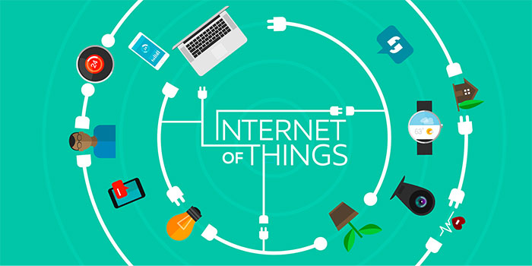
TECHNOLOGY STACK
Iot: Arduino and sensors are used to obtain the output of the project.
Sensor Technology: sensors are used to detect the food
Android Dev: it is the layout page which is used to store the data of the pet feeder machine.
Hardware: Different hardware components are used to make the machine
Machine learning: Different ml algorithms will be used to classify the food and track health patterns.

Slide 5
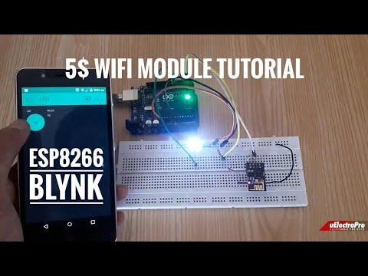

Slide 6
COMPONENTS
Microcontroller : Arduino Uno(ATmega328P) for controlling the
dispenser and other required task
Motor Driver : L293d for driving the Dispenser motor(we will
use L298n in final product)
WiFi Module : ESP8226 is used for connecting Arduino to the
Internet.
Power Supply : Using a 9v power supply for all the components
except arduino.
Sensors : IR sensor for feed status.

Slide 7
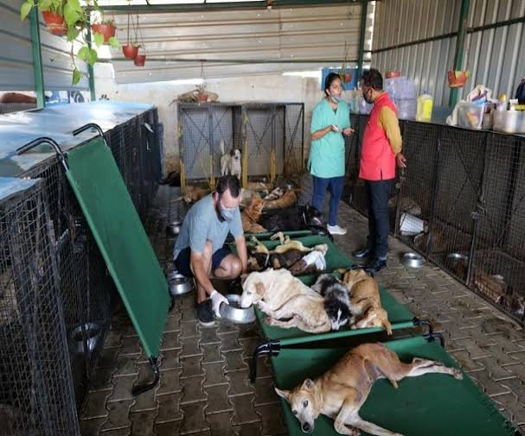
WORKING FLOW
SENSING - The sensors will work in order to sense the amount of food present in the vessel.
PRE DEFINED INSTRUCTIONS - The system will consist of pre- defined instructions based on the type of breed, age of the pet and accordingly the quantity of food will be stored to be followed. Hence, the empty space recognized by the system will be filled.
One time configuration INPUT FROM USER ( CELL NO. , AGE , BREED).- The user will have to enter some specifications into the system about number of cells,pets,their breeds and their age. Accordingly the project will automatically allocate the taksa to each specific cell.

Slide 8
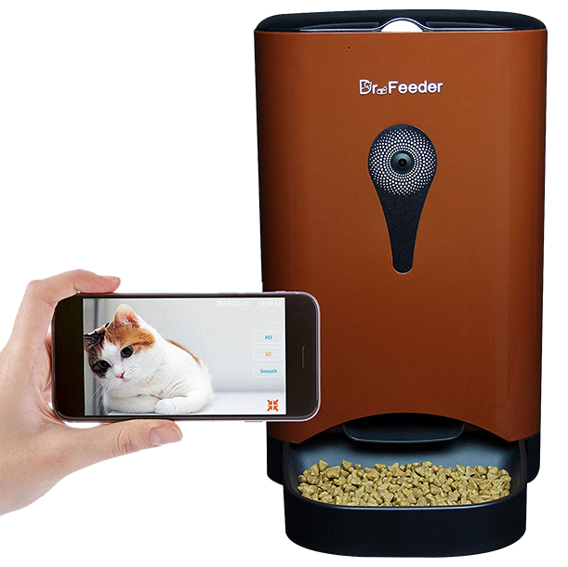
WORKING FLOW
QUANTITY OF FOOD IS DECIDED- The user can also decide to provide customized amount of food.
STATUS CHECK ON APP (IN PERCENT) - IoT Tech will constantly help the user to keep a track of everything that is going on through the application.
VARIOUS ALERTS ON THE APP TO KEEP A TRACK OF PET’’S EATING HABITS.- Alerts will also be passed on the app if there is anomaly detected in the system or any change in the eating pattern is noticed.
FOOD IS DISPENSED according to the default data
A basic version of IoT Pet Feeder

Slide 9
DFD - DATA FLOW DIAGRAM
USER
USER ID
VIEW USER
USER ID
SCHEDULE LIST
SCHEDULE
SCHEDULE ID
VIEW SCHEDULE
USER
FEEDING ORDER
FEED PET
FEEDING TIME
SENSOR DETAILS
VIEW SENSOR VALUE
SENSOR DETAILS

Slide 10
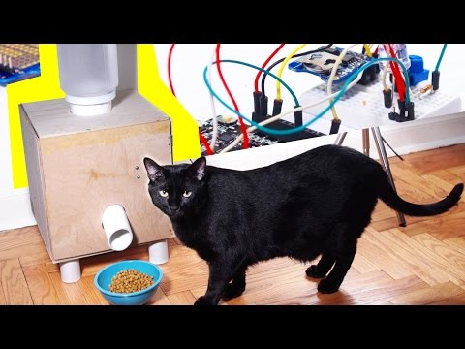

Slide 11
BLOCK DIAGRAM
Sensor Unit
Microcontroller Unit
Driver
Unit
Dispensing unit
IoT-ML Algorithm Unit
Mechanical Unit
Fig. Automation of feeder

Slide 12
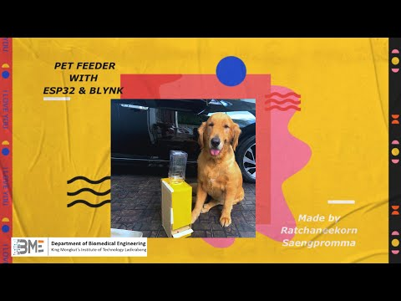

Slide 13
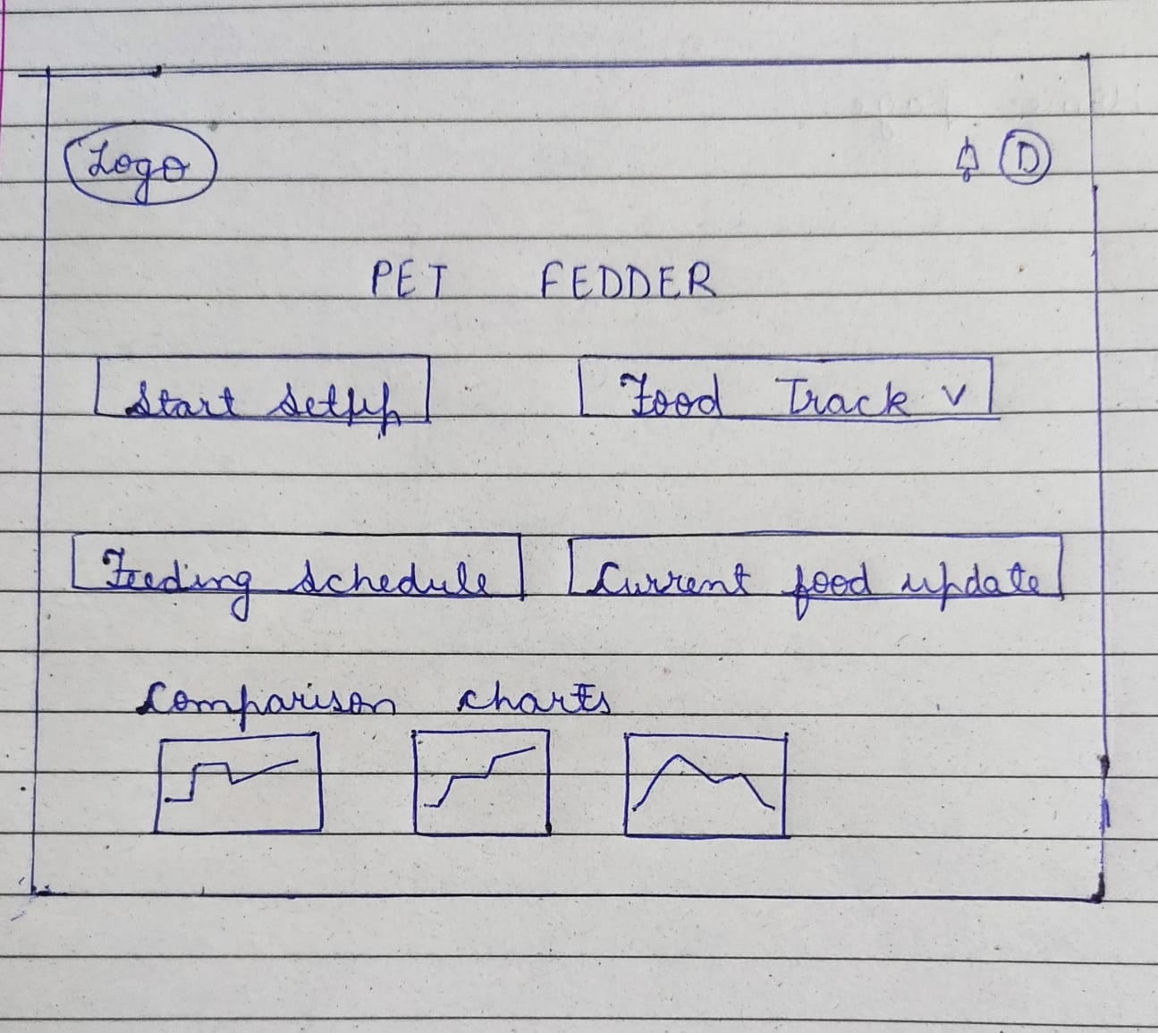

Slide 14
Sensing :
How to Select Load Cell/Weight Sensor?
The selection of a load cell for a specific application can be done by considering the following points.
Range of measurement
Based on application
Capacity requirements
based on size & specification requirements
Overload should be best
How to use a Weight Sensor / Load Cell + HX711 with an Arduino (brainy-bits.com)

Slide 15

COMPARISON
Existing Product
1. No real time interaction with the user
2. Fixed feed adjustment slots.
3. No overflow protection.
4. No feed indicator
Proposed Product
1. Real time interaction with the user (via mobile app).can be used for feed adjustment and feed status.
2. Variable feed adjustments.
3. Overflow Protection.

Slide 16
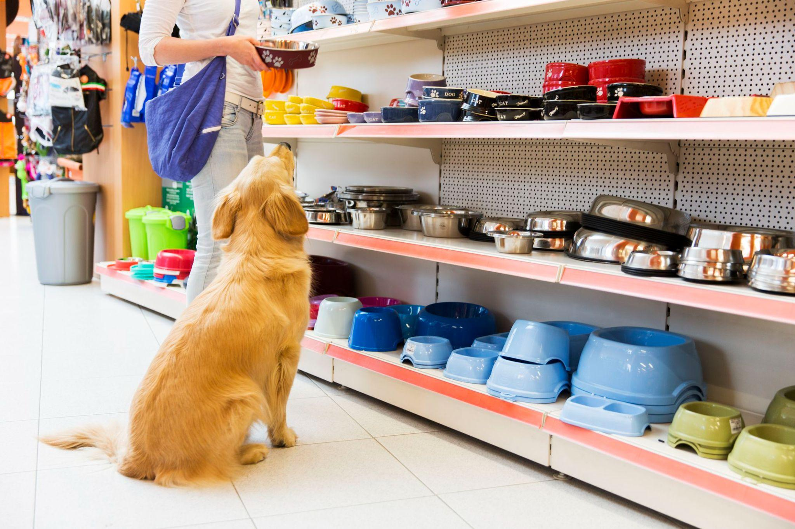
ADVANTAGES
1.Time saving-It will reduce the amount of time i.e. required for feeding pets.
2.One time investment-It’s a one time investment product with minimum maintenance cost.
3- Precision and Accuracy-It is going to provide quality measurement as all data is going to calculate by machine which reduces calculation mistakes.
4- Low cost-The product costs less comparatively.
4.Real time monitoring-It will provide the current status of diet of the pet as well as it will collect the data when a problem occurs.

Slide 17
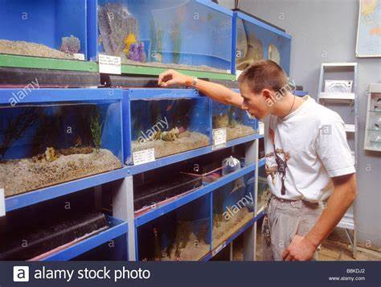
DISADVANTAGES
1.Machine dependency-Automated work leads to machine dependency.
2.Unemployment-Machine dependency will increase unemployment.
3.Less human interaction-As real time monitoring will provide all the data hence there’s no such need of human interaction.

Slide 18
REFERENCES AND PAPERS
Microsoft Word - IF-RIEECMEBANG-25075-600 (iraj.in)
(PDF) IOT based Pet Feeder (researchgate.net)
(PDF) IOT based Pet Feeder | Raed Abdulla - Academia.edu
Machine learning techniques in eating behavior e-coaching | SpringerLink
IoT Pet Feeder - Hackster.io
Benefits of using an automatic pet feeder in (slideshare.net)
(PDF) Towards Automatic & Personalised Mobile Health Interventions: An Interactive Machine Learning Perspective (researchgate.net)
How to use a Weight Sensor / Load Cell + HX711 with an Arduino (brainy-bits.com)

Slide 19
THANK YOU

